Slide 1
An Ounce of Monitoring – A Pound of Prevention.
Patrick K. McHugh – Source One Technology
Ryan Jonas – Greendale School District
Jesse Rink – Source One Technology

Slide 2
Source One Technology
Established in 2007
IT Services Provided:
Networking
Wireless (1:1 – BYOD)
Virtualization
Firewalls
Server Administration
Image Deployments
And much more…

Slide 3
Source One Technology
What makes us different?
No sales people
Experience in EDU (20+ Schools\Districts)
Vendor agnostic
No Service Contracts Required
Right-sizing solutions
Same face

Slide 4
Goals for This Session
Define Monitoring
Describe Effective Monitoring
List Examples of Monitoring Software
Demonstrate Real World Application

Slide 5
Monitor
Definition
Examples

Slide 6
Definition
a student appointed to assist in the conduct of a class or school, as to help take attendance or keep order.
2. a person appointed to supervise students, applicants, etc., taking an examination, chiefly to prevent cheating; proctor.
3. a person who admonishes, especially with reference to conduct.
4. something that serves to remind or give warning.
5. a device or arrangement for observing, detecting, or recording the operation of a machine or system, especially an automatic control system.
…
(Cite to dictionary.com)

Slide 7
Definition
…
Computers. a component, as a CRT, with a screen for viewing data at a computer terminal.
a control program.
a group of systems used to measure the performance of a computer system.
(Cite to dictionary.com)

Slide 9
http://www.saccade.com/writing/projects/PDP11/PDP-11.html

Slide 10
What is this?
http://www.saccade.com/writing/projects/PDP11/PDP-11.html

Slide 11
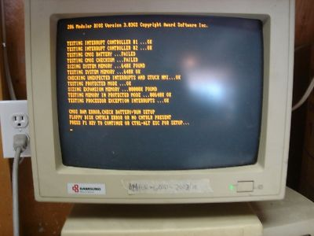
https://yourrootsareshowingdearie.wordpress.com/2013/03/page/2/

Slide 13
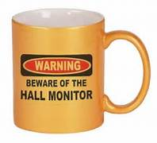

Slide 15
Effective Monitoring
Real-Time Picture
Trends
Strategic Monitoring

Slide 16
Real-time picture
Health
Maintenance

Slide 17
Trends
Baseline
Historic Comparison

Slide 18
Strategic Monitoring
Growth
Budgeting

Slide 19
Examples
Examples - Credit to Wikipedia

Slide 20
Examples
Log Files
Syslog Servers
Splunk
Fingbox
MRTG\Cacti
PRTG Paessler

Slide 21
PRTG – www.Paessler.com
Commercial
Priced per sensor – (Education Discount)
Frequent updates
Very Customizable – SNMP (MIBS), Custom Sensors
Server – Client, Web, Mobile
100 Free sensors

Slide 22
Realworld
Real-time Monitoring
Monitoring for Trends
Strategic Monitoring

Slide 23
Real-time Monitoring
“What’s going on?”

Slide 24
Basic Sensor - Ping

Slide 25
Exchange – Out of Control

Slide 26
Failed Hardrive

Slide 27
UPS Battery Life

Slide 28
Monitoring Backups

Slide 29
Monitoring for Trends
“Learning from History”

Slide 30
Standard Sensor Set

Slide 31
High Disk Reads on Server

Slide 32
Strategic Monitoring
“At this rate, we are certainly going to need more stuff.”

Slide 33
vCPU Sizing

Slide 34
Server Hard drive Usage

Slide 35
Internet Over a Year

Slide 36
Internet Over a Year

Slide 37
Questions?

